Slide 1
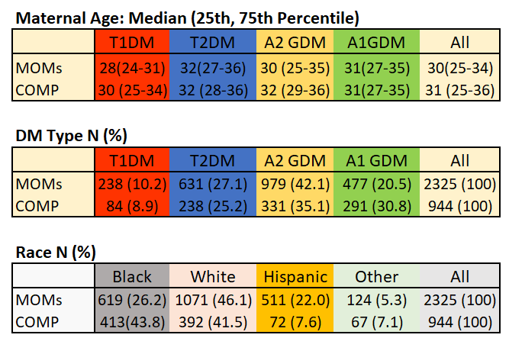
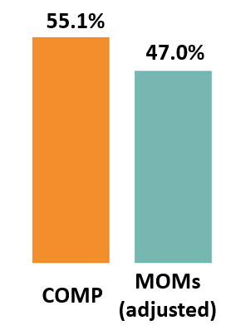
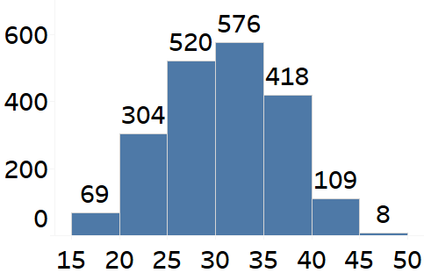
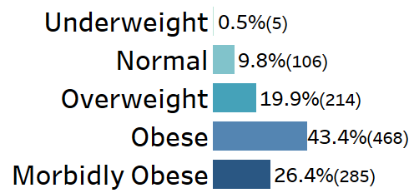
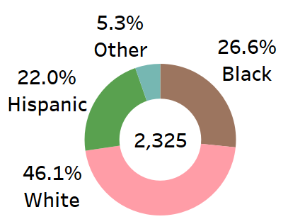
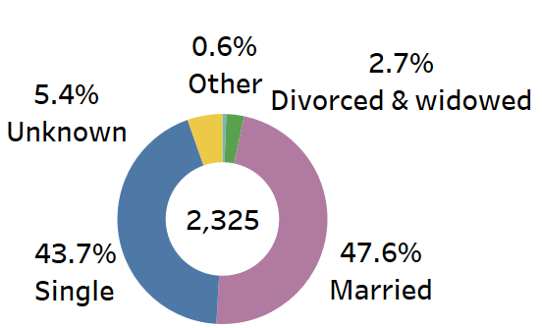
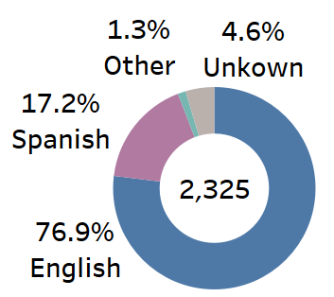
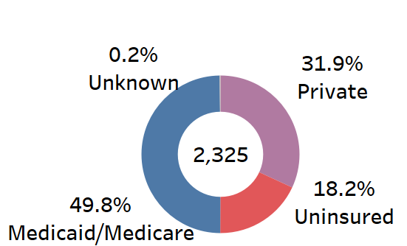
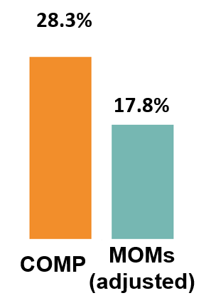
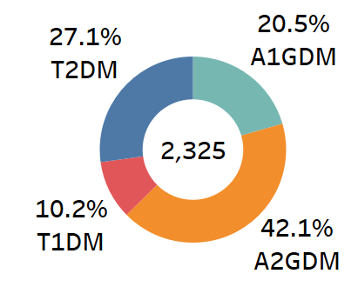
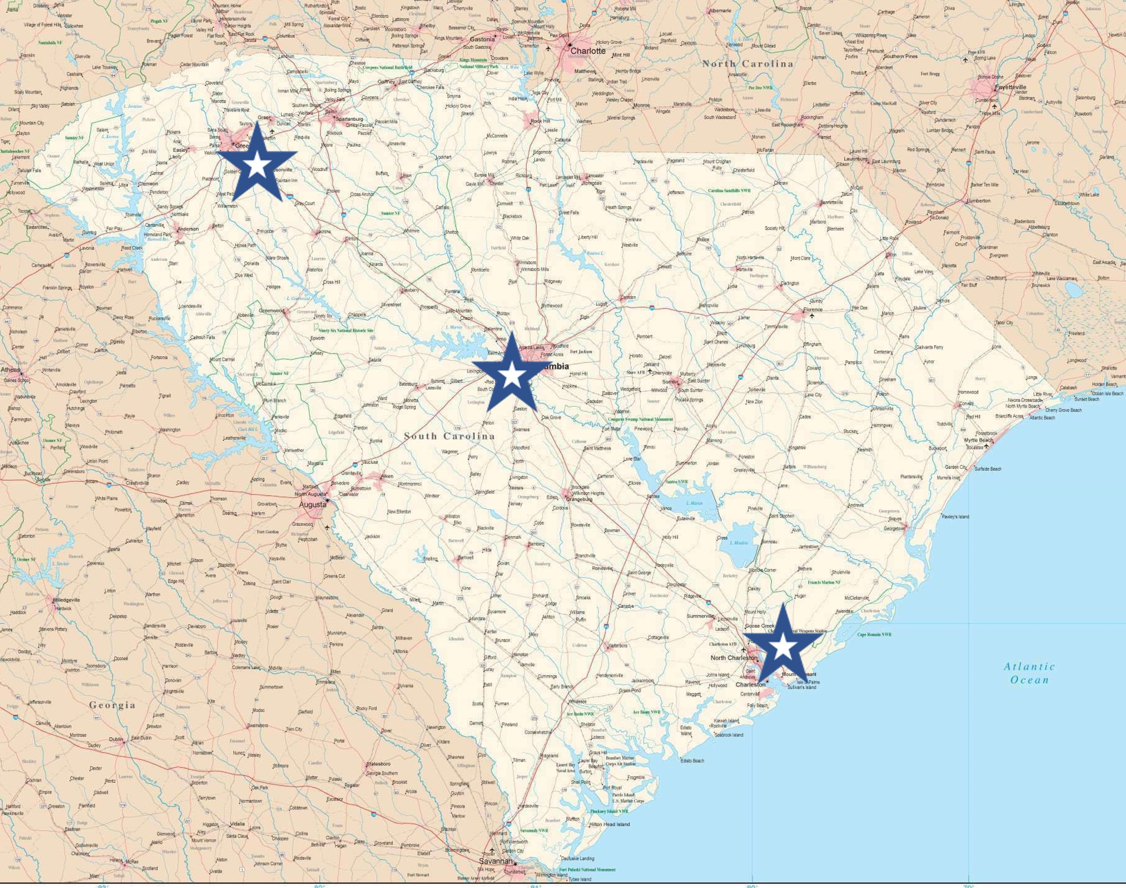
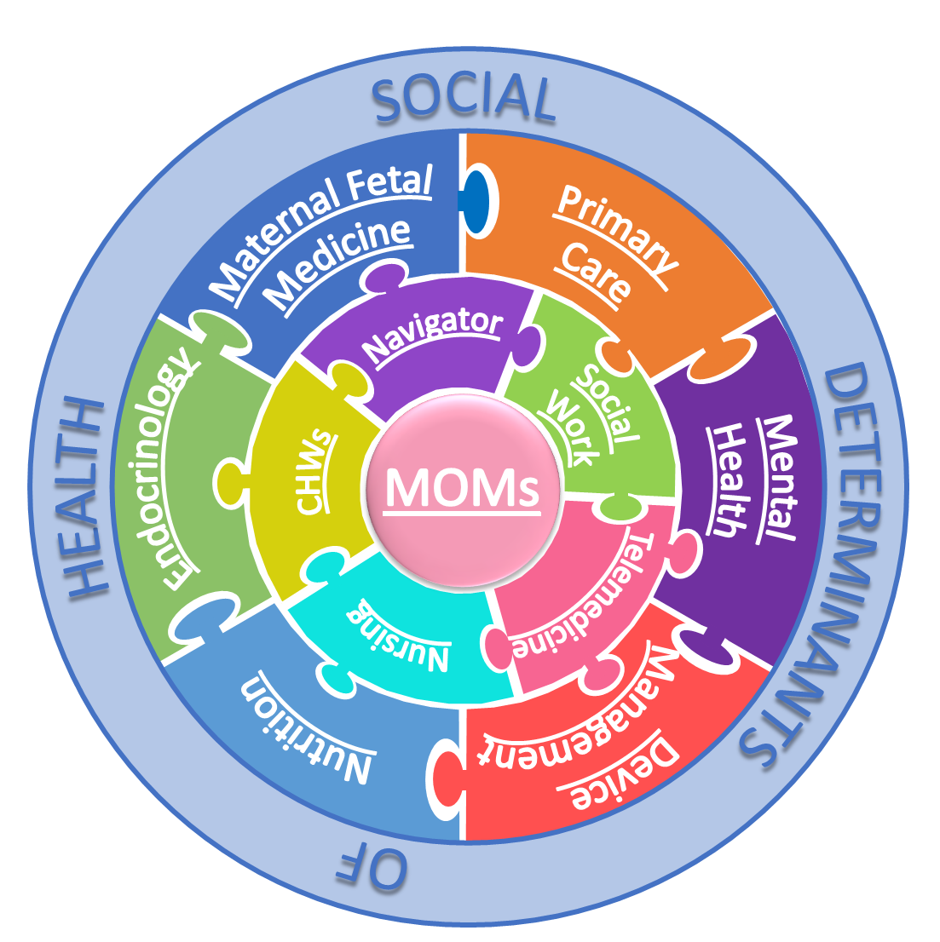
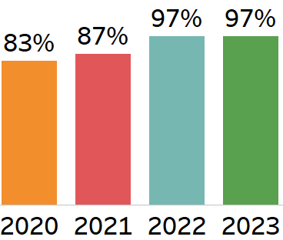
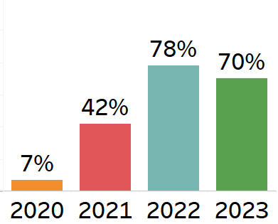
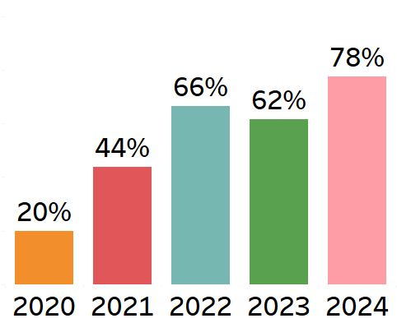
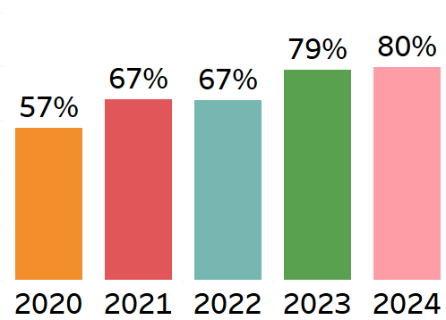
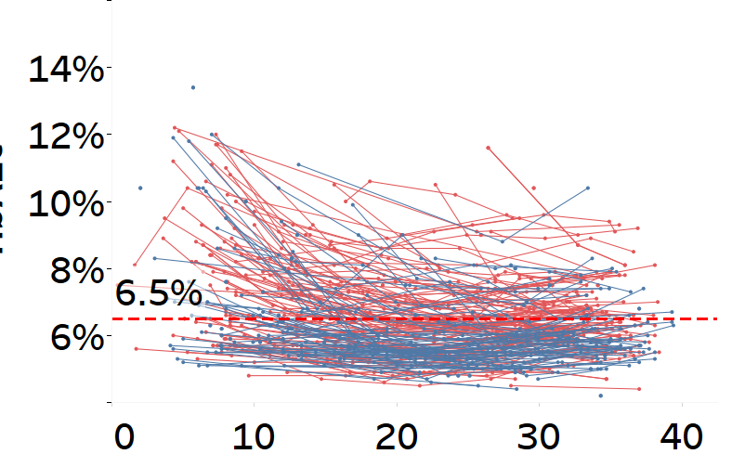
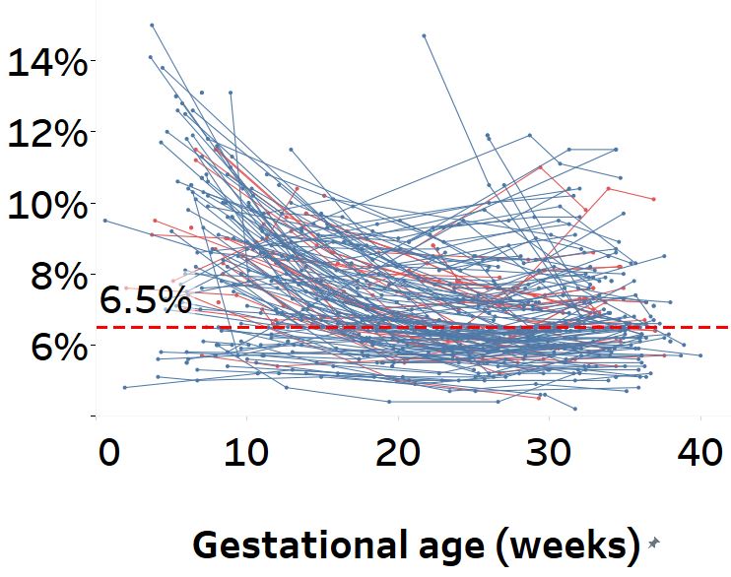
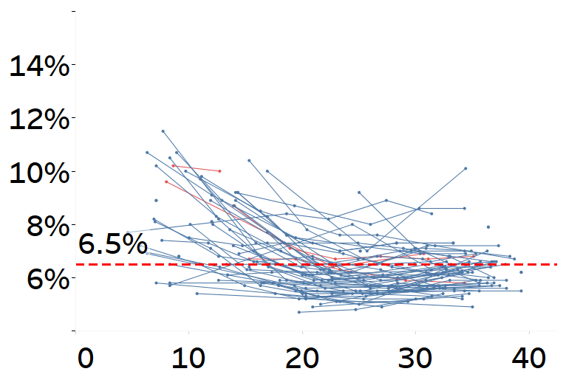
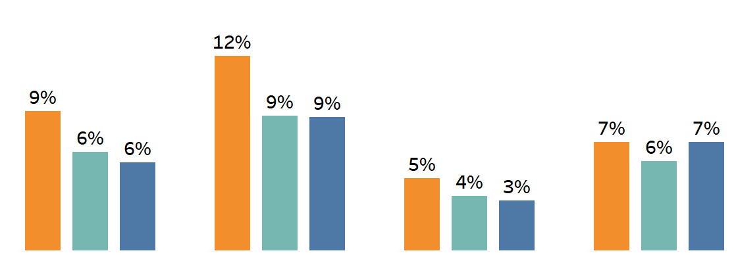
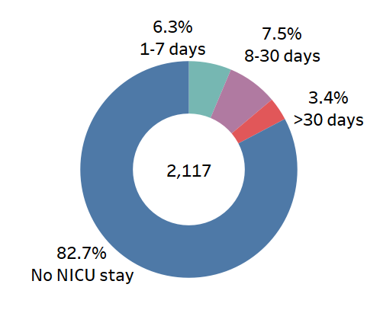
Assessing the Impact of the ‘Management of Maternal (‘MOMs’) Diabetes Program’ in South Carolina
Dongxu Fu ^{1,2}, Misti Leyva^{1,2}, Megan Schellinger³, Berry Campbell³, Courtney Cart⁴, Hannah White⁴, Jessica Britt⁴, Usah Lilavivat⁵, Makala Smith⁵, Matthew Finneran⁶, Maegan Manson², Kelly Hunt⁷, Timothy Lyons^{1,2} and MOMs Diabetes Program of SC.
Diabetes Free South Carolina, BlueCross BlueShield of South Carolina, Columbia, SC. 2. Division of Endocrinology, Medical University of South Carolina, Charleston, SC. 3. Maternal Fetal Medicine - 4. Department of Obstetrics & Gynecology –
5. Endocrinology, Prisma Health Upstate & Midlands, Greenville and Columbia, SC. 6. Division of Maternal Fetal Medicine - 7. Department of Public Health Sciences, Medical University of South Carolina, Charleston, SC
#
#
Introduction & Objective
Results: MOMs Cohort
Results: MOMs vs. COMP
Potential cost saving (South Carolina, yearly)
In South Carolina, risks of diabetic pregnancy are amplified by racial, economic, and geographic disparities, and by adverse social determinants of health (SDOH). Expert team-based care is essential: it must be equitable and feasible for both patients and providers, and must address real-life needs.
Objective: To improve pregnancy outcomes through a ‘Management of Maternal (MOMs) Diabetes Program’, implemented at three centers across SC. To emphasize a ‘one stop shop’, team-based approach, reducing disparities while optimizing the use of new technologies.
Maternal Characteristics
MOMs and COMP demographic comparisons
About 5,000 deliveries each year are complicated by diabetes in SC. If these outcome changes were achieved statewide:
Maternal Age
<18.5
18.5-24.9
25.0-29.9
30.0-39.9
>40.0
Pre-pregnancy BMI
Race
Patients with incomplete datasets were excluded, as were 46 twin pregnancies. For neonatal outcomes, only live births were analyzed (n=2325).
55.1%
47.7%
Reduction by 7.4 percentage points
Saving for
C-section
delivery
≡ 370 C-sections annually.
Outcome comparisons, MOMs vs. COMP, are shown in the Figures below. MOMs data were adjusted either by diabetes type (in each race) or by both diabetes type and race (in all patients)
Cost saving per C-section: $4,681
Total saving each year:
$1.7M
Diabetes type
Marital status
Language
Insurance
28.3%
Reduction by 8.3 percentage points
MOMs Program locations
MOMs Model Schema
NICU admission rate
Saving for
NICU
Admission
20.0%
≡ 415 NICU admissions yearly
Total C-section Prevalence
Cost per NICU
admission (estimated): $71,158
*
**
*
P=0.08
**
**
**
Total saving each year:
Improvements in Care, 2020-2024
**
$29.5M
Mental health screening
Retinal screening
T1DM &T2DM only
Use of continuous glucose monitor (CGM)
Returned for
postpartum care
To these short-term savings may be added many long-term, durable benefits and health-related cost savings for mother and child, extending years and decades into the future.
All Black White Hispanic
All Black White Hispanic
Percent Screening
Percent Screening
Percent Using
Percent Returned
Neonatal Hypoglycemia
Neonatal hospital stays > 7 days
Summary & Conclusion
Methods
**
Implementation of the MOMs program was associated with fewer C-sections, NICU admissions, pre-term births and episodes of neonatal hypoglycemia, and improved APGAR scores. However, emphasizing the continuing challenge of racial disparities and the need for redoubled effort, benefits were generally greater for White than Black patients.
MOMs programs were implemented in 2020 at the Medical University of SC (Charleston), and at two Prisma Health locations: Midlands (Columbia, Sumter) and Upstate (Greenville). The team approach aimed to enhance patient-provider communication, educate everyone, utilize new technologies, reduce clinic visits & travel, and address SDOH.
Core team members/components were: Maternal Fetal Medicine, Endocrinology, RN/RD Diabetes Educators, Navigator, Retinal Screening, and Telemedicine. Coordinated, de-identified clinical data were collected at each location and incorporated into a Diabetes Free SC repository. Since 2020, MOMs Programs have cared for about 3,000 pregnancies. Data reported are from 2,325 with deliveries in 2020-2024,July.
MOMs outcomes were compared with 944 patients in a ‘standard care’ comparator group (COMP) from the Medical University of South Carolina perinatal database (2017-2019). Distributions for maternal age were similar between MOMs and COMP, but COMP had a higher proportion of Black patients and a lower proportion with T1DM. MOMs data were adjusted accordingly. Full cohort comparisons are presented. Statistical analyses used Two Proportion Z-Tests (p<0.05).
Mental health and retinal screening only include 2022-2023; 2024 data is pending.
CGM and PP data exclude A1GDM, MUSC telemedicine, and Prisma MFM patients due to limited data
**
**
**
**
*
*
*
HbA1c throughout pregnancy: Pregestational T1DM &T2DM only
All Black White Hispanic
All Black White Hispanic
White
Black
Hispanic
Large for gestational age
Small for gestational age
Acknowledgements
Diabetes Free SC recognizes the outstanding skill and commitment of the team leaders and members at the three MOMs sites. MOMs Programs are funded by the BlueCross BlueShield of South Carolina Foundation to support the goals of Diabetes Free SC. MUSC MOMs Program was also supported by The Duke Endowment. We acknowledge the support of Noreen O’Donnell, DFSC Program Director, and the following team members:
HbA1c
**
**
**
P=0.06
Gestational age (weeks)
Gestational age (weeks)
Gestational age (weeks)
All Black White Hispanic
All Black White Hispanic
Medical University of South Carolina : Meghan Blanchette, RN Ryan Cuff, MD Matthew Finneran, MD Constance Guille, MD Barbara Head, MD Donna Johnson, MD Elizabeth Johnson, RD Harsha Karanchi, MD Emily Kobus, NP-C, APRN Aundrea Loftley, MD Joye Louie, MPH James McElligott, MD Joni Nelson, PhD Angel Payton-Harmon, MSW Emily Rosenberg, MD Edith Williams, PhD
Prisma Health Midlands Delaine Barefoot, RDMS Vanessa Bradford, PSR Tracey Campbell, RD Kathryn Capan, FNP Ashia Culler, PSR Mitzi Epting, MS Kristina Huggins, CMA Julia Kimsey, MSN Jihong Liu, PhD Dorothy Mclean, CHW Tonya Seawright, CHW Amanda Tindal, RN Susan West, RN.
Prisma Health Upstate: David Londono Acevedo, CCHW Johanna Bruen, RDN Linda Perez-Cano, RN Kathy Fincher, RD Casey Fiocchi, RD Kathryn Hunt, RN Sharon Keiser, MD Alexis Kelly, BS Emma Klipstein, RN Jessica Odom, PharmD Patti Parker, RN Danny Pasko, MD Pamela Schult, NP Michelle Stancil, RN Sandra Weber, MD Donna West, RN .
Infants: Duration of NICU stay (days)
Preterm birth (<34wks)
Low 5-minute APGAR score (<7)
All patients
**
*
**
*
**
By diabetes
type
**
**
All Black White Hispanic
All Black White Hispanic
By race
statistical significance: *p<0.05, **p<0.01, “MOMs adjusted ” vs. COMP

